Slide 1
Coffee Bean Sales ☕️
Data Insights and Decision-Making

Slide 2
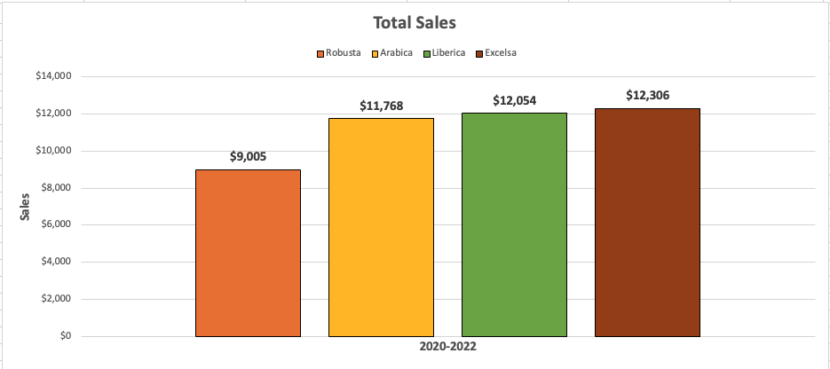
Total Sales
Insight: Robusta consistently sold the least over four years, while the average values of the other three types remained relatively similar.

Slide 3
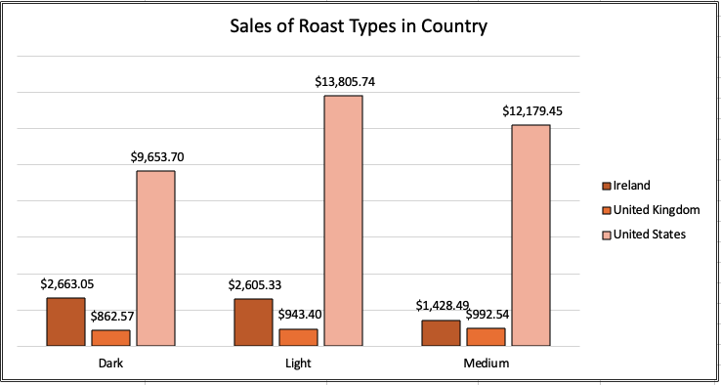
Roast Types and Sales by Countries
Ireland and UK --> lower overall consumption rates (dark, light).
The United States --> high consumption of caffeine (diverse preferences).
Insight 1: In Ireland and the UK, a preference for milder flavors or potentially a cultural inclination towards tea over coffee.
Insight 2: The United States has the high consumption of caffeine with diverse preferences from customers compared to Ireland and the UK.

Slide 4
Sales:
POTENTIAL REASONS:
Cultural Differences:
Coffee is ingrained in American culture often associated with socializing, work and leisure activities. Tea play a more prominent role in the culture of Ireland and UK.
2. Beverage Preferences:
US, coffee is a dominant choice, diverse of specialty coffee shops and strong culture of it. For Ireland and UK, Tea is often a more prevalent choice in early years.
3. Marketing strategies:
US, caffeinated beverages tend to have higher exposure such as energy drinks, sodas and coffee causing in higher consumption rates. Ireland and UK always focus on marketing in Tea industry resulting in fewer caffeinated products actively promoted related to cultural preferences.
4. Work and Lifestyle Factors:
US(long work hours → dealing with tiredness → higher caffeine intake);
UK and Ireland(work-life balance → shorter work hours → lower caffeince intake).

Slide 5
Distribution of Roast Coffee Types:
United States:
Diverse preferences of coffee drinkers→ The coffee market in the US is highly competitive and caters to a wide range of tastes, with consumers enjoying everything from bold, rich dark roasts to lighter, fruitier options. Coffee chains, specialty coffee shops, and supermarkets typically offer a variety of roast types to meet the demands of different customer segments.
Ireland and the UK:
Historical Coffee Consumption Habits → Dark roast coffee, with its strong flavor profile and bold taste, might appeal to consumers who enjoy a more robust coffee experience. Light roast coffee, on the other hand, may be favored by those who appreciate the nuanced flavors and acidity characteristic of lightly roasted beans.

Slide 6
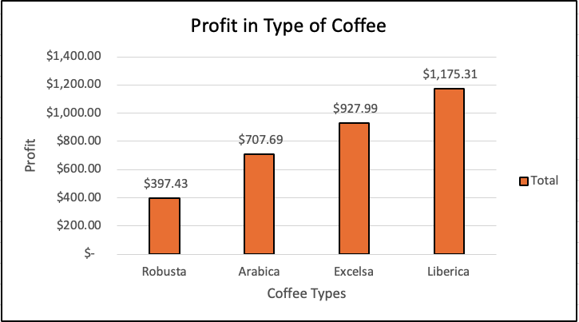
Profit in Type of Coffee
Insight:
Even though the Liberica only has fewer orders, the Profit occupied the top.
Arabica and Excelsa, being the popular and most ordered products, contributes moderately to the profits.
Robusta only has contributed small range of profit since it only has the lowest sales.

Slide 7
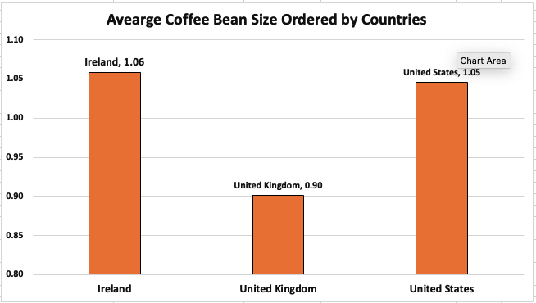
Result:
Ireland: 1.06
United States: 1.05
United Kingdom: 0.90
Insight: The average size from coffee beans ordered in Ireland is higher than in the US, even though the US has the highest total quantity of orders.
Most people in Ireland prefer larger coffee size products. Meanwhile, people in the UK prefer to order small coffee bean size products.

Slide 8
Strategies to Improve Sales
Marketing: Focus on marketing medium coffee bean sizes to cater preference of smaller order in the UK. (Launching campaign)
Target Markets: Concentrate marketing and promotional efforts on Ireland and the US, as customers from these regions tend to spend more per order, maximizing profitability.
Product Focus: Increase marketing for Liberica coffee since this product contributes significantly to profits. Therefore, increasing its sales could lend to higher overall profits.
Robusta Optimization: Explore strategies to increase Robusta’s profitability by highlighting its unique taste or creating unique flavor profiles. (Collaboration with famous Barista to create signature coffee-based recipes using Robusta)
Market Research and Feedback: Continuously gather feedback and conduct market research to understand consumer preferences and trends, ensuring the effectiveness of marketing initiatives. (Survey or Email to gather feedback from customers about coffee preferences and purchasing experiences)

